Slide 1
Sea Peoples
Philistines and/or similar groups of raiders or displaced peoples
Part of a series of events that leads to the Late Bronze Age collapse of several kingdoms and empires
Egypt provides the most evidence, beginning during 13th century BC
Ends as we focus on the first kings of Israel

Slide 2
The Philistines Enter History and Canaan Rameses III ca. 1177 BC
“They were coming forward toward Egypt… Their confederation was the Tjeker, Shekelesh, Denye(n), Wehesh and the Peleset (Philistines).”
Philistine Captives in Feathered Headdress
Medinet Habu, Egypt
“The words spoken by the fallen ones of Peleset [the Egyptian name for the Philistines], ‘Give us the breath for our nostrils thou king, son of Amon.’”
Biblical Archaeology Review 19:5, September/October 1993
The Philistines and the Dothans: An Archaeological Romance, Part 2

Slide 3
The Philistines, the Tjeker, the Shekelesh, the Denyen, the Wehesh
The naval battle between the Sea Peoples and the Egyptians in about 1177 B.C. (The photo coincides with the area marked on the left side of the drawing.). The horned helmets at center are the mark of a Sea People named the Shardana; the more common feathered headdresses, resembling upright brushes, identify the Philistines and other Sea Peoples.
Biblical Archaeology Review 19:5, September/October 1993
The Philistines and the Dothans: An Archaeological Romance, Part 2

Slide 4
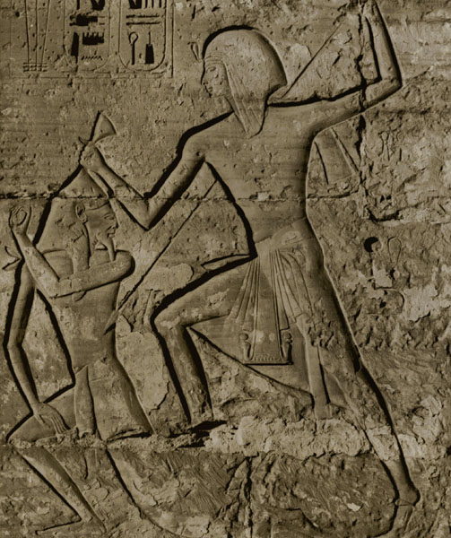
Ramesses III Battles The Philistines
Ramesses III campaigned against Sea Peoples (including Philistines), as well as Shosu Bedouin, and brought them back as prisoners of war. According to the first section of the Papyrus Harris (one of the longest ancient Egyptian papyri still in existence, now in the British Museum), most of these Shosu Bedouin were dispersed among the main temples as slaves. Many scholars follow Raphael Giveon in identifying the early Israelites as a faction of the Shosu Bedouin.9 In any event, it is clear that the majority of early Israelites came out of this pool of wanderers.
Biblical Archaeology Review 29:5, September/October 2003
Israelites Found in Egypt
Ramesses III smiting a Philistine.

Slide 5
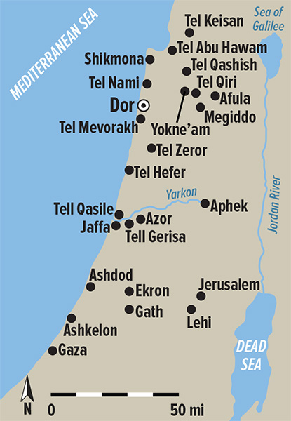
Sea Peoples
The Philistines, who established five prosperous cities—the Pentapolis (Ekron, Ashdod, Gath, Ashkelon, and Gaza)—on the southern coast of the Land of Israel, were just one tribe of Sea Peoples.
Biblical Archaeology Review 40:6, November/December 2014
The Other “Philistines”

Slide 6
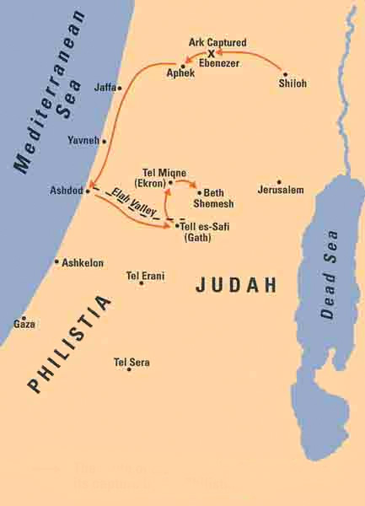
The route of the Ark of the Covenant after its capture by the Philistines
Biblical Archaeology Review 27:6, November/December 2001
Excavating Philistine Gath: Have We Found Goliath’s Hometown?

Slide 7
Joshua’s Altar on Mt. Ebal
Joshua 8:30
“Then Joshua built an altar in Mount Ebal to the LORD, the God of Israel.”
BAS Library Collections - Where Did the Early Israelites Come From?
https://members.bib-arch.org/collections/where-did-early-israelites-come
The rectangular altar on Mt. Ebal was once filled with alternating layers of earth, ash and fieldstones. Here, inside the altar’s exterior wall, bordering the edges of the photo, we see the excavation of the fill in progress.
Biblical Archaeology Review 11:1, January/February 1985
Has Joshua’s Altar Been Found on Mt. Ebal?

Slide 8
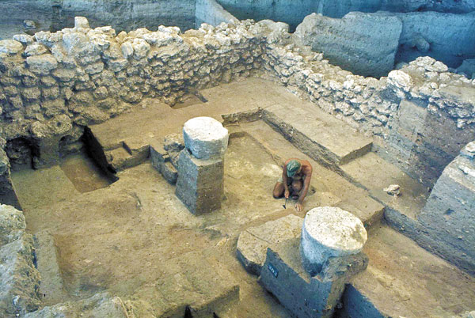
Pillar Bases of a Philistine Temple
Judges 16:29-30
“Samson grasped the two middle pillars on which the temple rested, the one with his right hand and the other with his left. And Samson said, "Let me die with the Philistines!" And he bent with all his might so that the temple came crashing down.”
The use of cedar in royal structures was not limited to the Phoenicians and Israelites. Excavations of a Philistine temple at Tell Qasile revealed two cedar logs from the 11th-century phase of the structure—one in the vestibule and the other in the main hall. The evidence suggests that two round column bases in the temple held cedar pillars that supported the roof.
Biblical Archaeology Review 39:3, May/June 2013
Cedars of Lebanon: Exploring the Roots

Slide 9
Shiloh
Collar-rim storage jars lean neatly against a wall at Shiloh. Their round bases are still inserted in the dirt floor. The large vessels are propped up by an Iron Age wall in Area C. Not wanting to disturb the impressive vessels in their final resting place, a volunteer carefully brushes off the surface soil. The distinctive collar-shaped rim is clearly visible in the fourth storage jar from the front. The large stone slabs, foreground, are part of the floor of a probable storage room. The black, burnt soil behind the flagstones evidences the destruction of Shiloh by the Philistines in the mid-11th century B.C.
Biblical Archaeology Review 12:1, January/February 1986
Shiloh Yields Some, But Not All, of Its Secrets

Slide 10
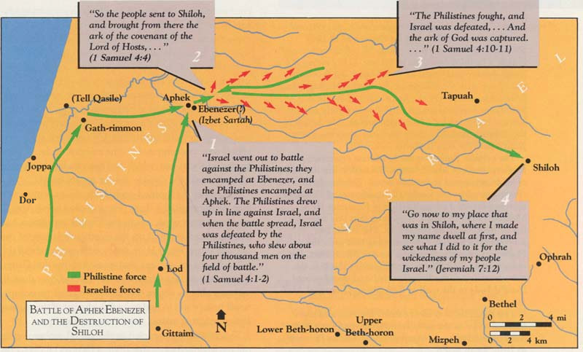
Battles With The Philistines and the Destruction of Shiloh
Biblical Archaeology Review 12:1, January/February 1986
Shiloh Yields Some, But Not All, of Its Secrets

Slide 11
Period of the Judges 1200-1000 BC
Hundreds of small settlements appear in Iron Age I (1200–1000 B.C.E.) that can now be identified as the ancient Israelites settling down.
Biblical Archaeology Review 35:6, November/December 2009
How Did Israel Become a People?

Slide 12
The Four-Room House
This well-preserved four-room house was uncovered at the Iron Age I site of Izbet Sartah in the Judahite hill country. Such houses, characterized by rows of pillars and walls dividing the dwelling into three long rooms and an adjoining broad room (highlighted in red), were common to hill-country settlements of Iron Age I. The plan was uniquely adapted to the simple agrarian life of these settlers and may, as Avraham Faust argues, be another reflection of the egalitarian ethos that distinguished the Israelites from their wealthier and more cosmopolitan neighbors.
Equally important, the four-room house became the house of choice for almost every Israelite family during the succeeding Iron Age II, the period when Israelite ethnic consciousness and identity are fully attested in both Biblical and extra-Biblical sources.
Biblical Archaeology Review 35:6, November/December 2009
How Did Israel Become a People?

